Slide 1
The Psychology of Happiness
Chukwudi Ikem
November 19th, 2019
CSUF; CPSC 311
Professor Peralta

Slide 3


Slide 4
Argument from Happiness

Slide 5

The Verdict

Slide 6
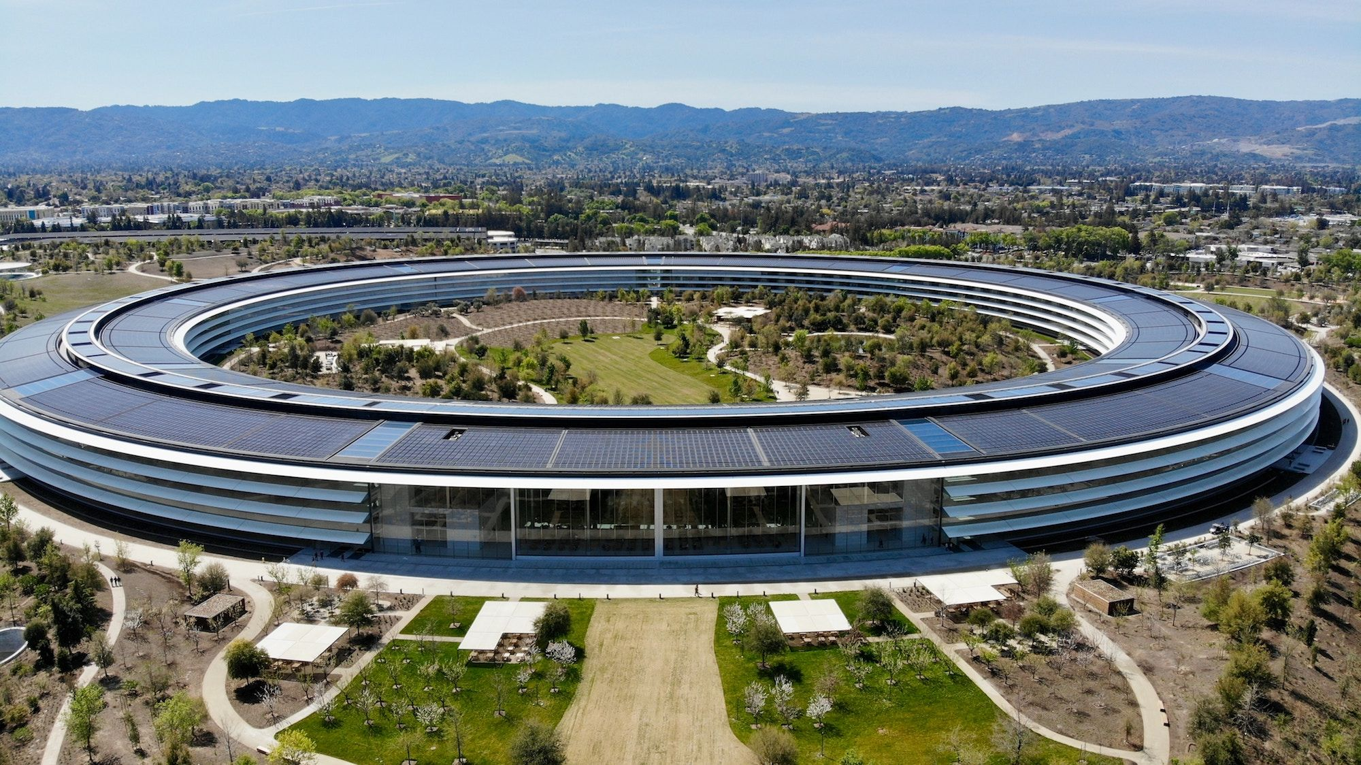

Slide 7
Silicon Valley
Silicon Valley
Hub for technology corporations
It is home for the largest tech corporations in the United States, region where the microprocessor and microcomputer were developed.
Google, Facebook, Chevron
If you love technology, SIlicon Valley is the place to be ..
We all know it is very expensive to live in the Bay Area.
The traffic is terrible, the average commute time can get up to 90 minutes one way. The average commute time per year went up by 40 hours from 2008-2017.

Slide 8
What does this mean?
The Bay Area is home to around 7 million people. Silicon Valley takes up about half of total population.
The region of Silicon Valley alone is home to seven times more people than the capital of California itself. (keeping in mind that Sacramento is the sixth largest city in the state)

Slide 10

Where does happiness play a factor?
How many people are happy to live in an area where they are overcharged for housing (making six figures and barely affording an apartment).
An area where the commute time can range from an hour to an hour and a half.
An area where.. let’s be honest. For every plain women there are 50 rich men.
Your chances are slim.

Slide 11
What does Detroit have?
We Have:
The culture. Detroit is the birthplace of techno music.
Birthed many famous musicians. Madonna, Eminem.
Our theatre district in the second largest in the country.
We Also Have:
Violence
Unemployment
These are all things that make people unhappy.

Slide 12
What does Detroit need?
Take care not to forget that in 1990, this city was populated with almost 2 million people, in 2016 Detroit had a little less than 700,000.
The people need a reason to stay, they need to find a higher purpose in this city. They need to be happy, in this city.
This city does not have the morale. We are a constant divide between ourselves.
We all know that Detroit has a crime problem. According to 2010 data analyzed by the Detroit News, homicide is the leading killer of children over age 1 and under 18 in Detroit. Local leaders have witnessed Detroit’s employment rates at all-time lows.
But what did you expect to happen when people are jobless, they turn to crime to survive.

Slide 13
Boost Morale - Feedback Loop
We must increase our confidence in this city so that its citizens will fight for this city and ensure it is one in which people can be happy and productive.
We cannot clip a bird's wings and wonder why it cannot fly.
The cities issues are rooted in their current standards of living, because people are unemployed and unhappy they must resort to different methods of survival.
Although not all of Detroit is crime infested, the crime in Detroit brings down the overall morale and public view of the city.

Slide 14
City Thrives
Population growth, improved local economy. Improved City.
Upgrade City
Infrastructure
(roads,sewage, schools, education, etc)
By upgrading our city infrastructure in preparation for Tech Inc. we are able to start a feedback loop.
Tech Inc. Loop
The City Improves More
Unemployment rates go down, crime goes down. Improves city perception, morale and happiness.
Tech Inc.
Tech Inc. creates jobs for people, generates revenues, increases city value.

Slide 16
Issues with a Park
I believe local parks do have the ability to increase social ties between people in a local community. My issue is not with the physical park itself, but rather the scope of the park.
A scholarly publication by Aleksandra Kazmierczak claims that for inner-city parks to realise their full potential in supporting social interactions and developing social ties, they need to be well-maintained and provide good recreational facilities.
Not only will it cost plenty of money to maintain, there are many uncertainties involving the return on investment.
A more highly programmed, designed and maintained park in Minneapolis may cost $6,000,000 to $8,000,000 per acre to develop and $500,000 to $700,000 to operate, while a park with fewer features and programming may cost $1,000,000 to $3,000,000 to develop and $200,000 to $400,000 to operate. These estimates do not include land acquisition costs.

Slide 17
The Numbers
The population of people in Minneapolis is similar to that of Detroit.
We can assume that pricing will be around the same around.
Say it costs $5,000,000 to develop and operate a park in Detroit.
The average operating costs per year is typically from $200,000 to $1,000,000 depending on the park.
Tech Inc., like the park, is buying land that belongs to Detroit, so regardless our city will profit.
The difference is.

Slide 18
How do I know that Tech Inc will increase the cities value?
Tech Inc. is an American multinational technology company that specializes in Internet-related services and products, which include online advertising technologies, search engine, cloud computing, software, and hardware.
Tech Inc. closely revivals the presence of Google.
Just the idea of having Tech Inc reside in Detroit may already start to reform people’s opinions of our city.

Slide 19
Why Tech Inc?
As of November 2019, Tech Inc. has 120,000 employees.
Just like how Anahiem is known for having Disneyland, we can reform the perception of Detroit as one not of violence and vice, but one of technological advancement and reform.
With the headquarters of Tech Inc. in Detroit we can achieve more by supplying jobs, and boosting our local economy.
The people’s company

Slide 20
Win | Win
Tech Inc. has similar statistics to Google. It is an engine of economic growth, generating $139 billion in economic activity through more than 2 million businesses and nonprofits nationwide.
While it is true that not all of the money generated will stay in Detroit, we can expect redistribution of wealth from the headquarters to their employees.
Detroit will be known as the city that houses Tech Incorporated. Detroit will be known for its technology.

Slide 21
Citing Sources
[1] “According to 2010 data analyzed by the Detroit News, homicide is the leading killer of children over age 1 and under 18 in Detroit. Local leaders have witnessed Detroit’s employment rates at all-time lows.”
https://www.huffpost.com/entry/detroit-highest-murder-rate-violent-crime_n_6144460
[2] https://www.colorpsychology.org/color-psychology-marketing/
[3] “inner-city parks to realise their full potential in supporting social interactions and developing social ties, they need to be well-maintained and provide good recreational facilities.” https://www-sciencedirect-com.lib-proxy.fullerton.edu/science/article/pii/S0169204612001569

Slide 22
Citing Sources
[4] “The average commute time can get up to 90 minutes one way. The average commute time per year went up by 40 hours from 2008-2017.”
https://www.commercialcafe.com/blog/are-you-living-in-one-of-the-cities-where-commuting-time-increased-the-most-or-least/
[5] “A more highly programmed, designed and maintained park in Minneapolis may cost $6,000,000 to $8,000,000 per acre to develop and $500,000 to $700,000 to operate, while a park with fewer features and programming may cost $1,000,000 to $3,000,000 to develop and $200,000 to $400,000 to operate. These estimates do not include land acquisition costs.”
http://cloud.tpl.org/pubs/ccpe-DowntownParkFinance-inMN.pdf
[6] All Images from https://google.com/imghp

Slide 23


Thank you for listening!

Slide 24
Feel Free to Contact Me: 1-800-616-1610

